Slide 1

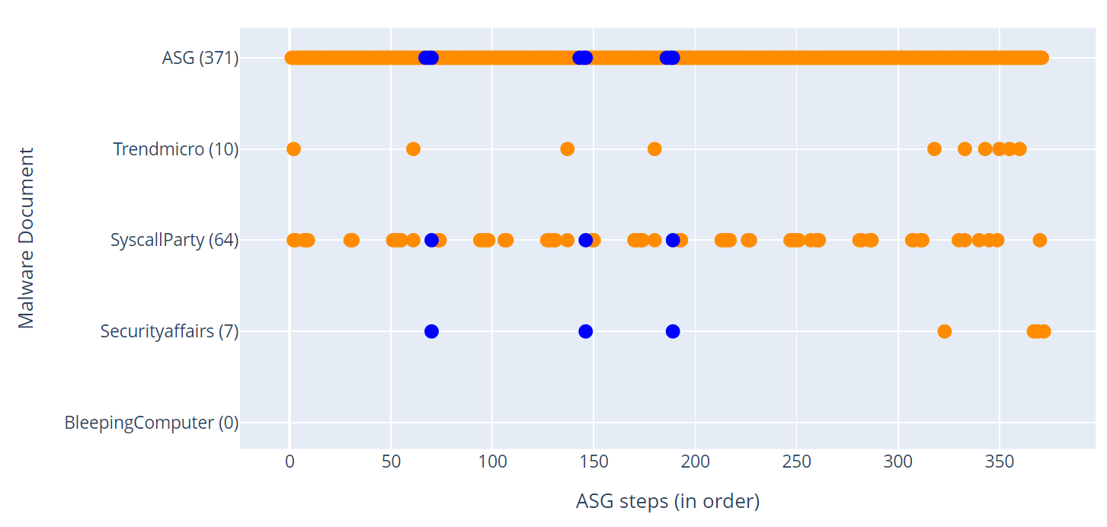
D_{1,4}
(2) Discovery: read host settings /proc/stat, /proc/net/dev
D_{1,3}
D_{1,2}
(1) Persistence: register malware to init script
(3) C&C: provide shell to attacker
D_{1,1}

